Slide 1

CSA0888:Python Programming for Natural Language Processing K. Varun(192210536) K. Satya(192210560)

Slide 2
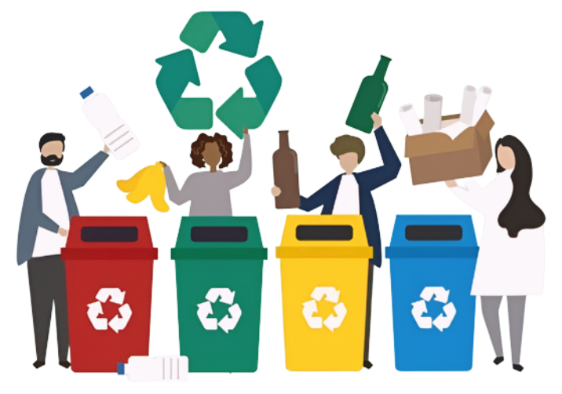
PYRHON PROGRAMMING FOR SMART SWEEPING "

Slide 3
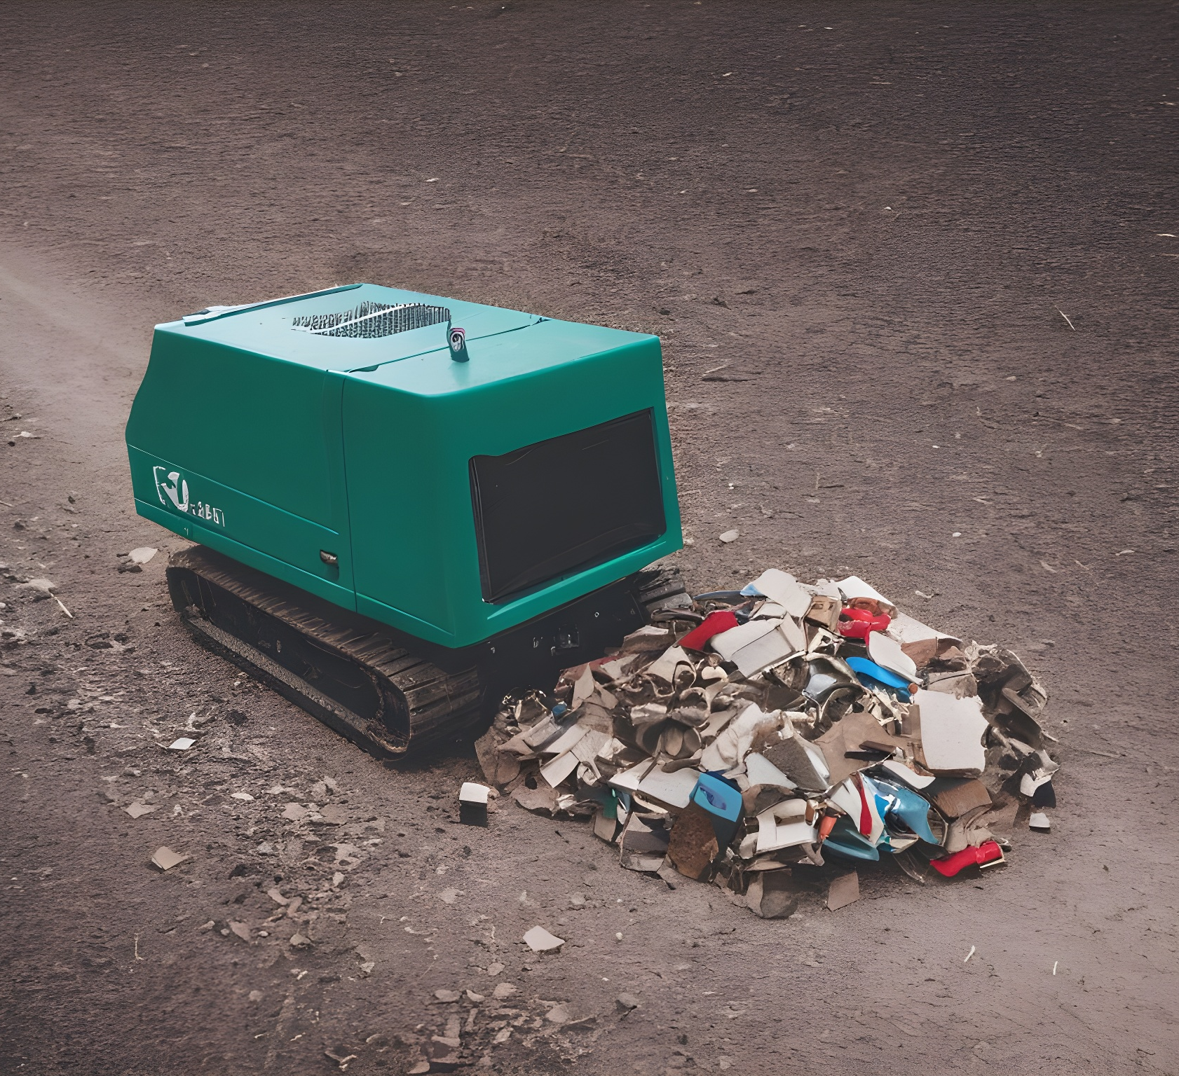
Introduction
Innovating waste management through machine learning for efficient garbage detection and sorting.
This presentation explores the potential of AI in waste management.
Current waste management systems face challenges in inefficient sorting and contamination.
Traditional methods struggle to handle the growing volume of waste.
Using machine learning algorithms, waste can be accurately identified and sorted, leading to reduced contamination and increased recycling rates.
By accurately identifying recyclable materials, organic waste, and hazardous substances.

Slide 4
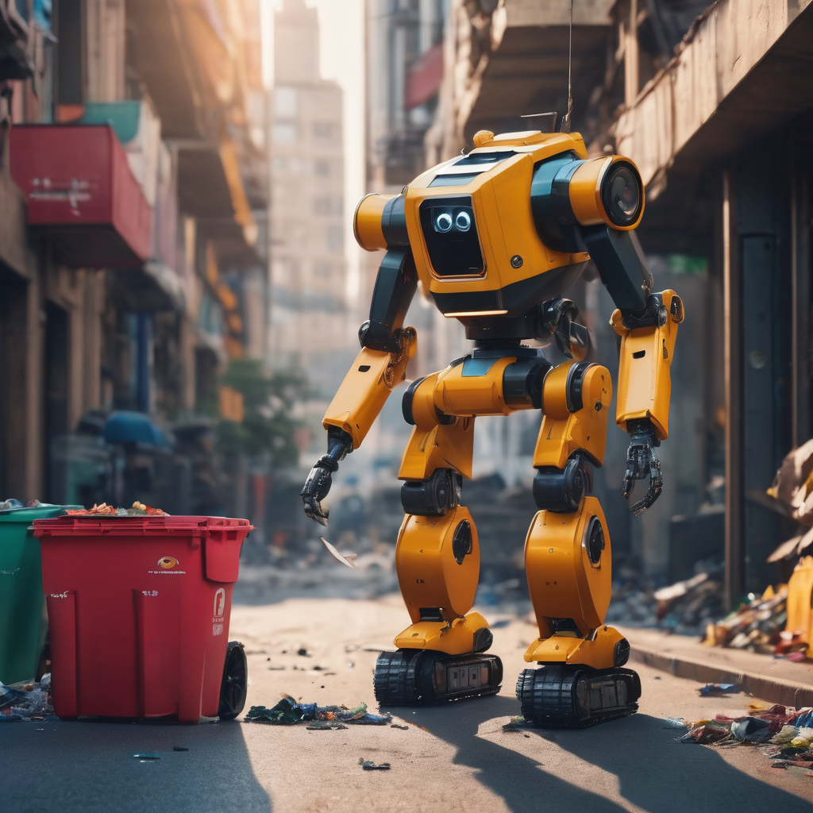
Abstract
The proliferation of waste, particularly non-biodegradable materials, poses significant environmental challenges worldwide.
Traditional methods of waste management often rely on manual sorting processes, which are labor-intensive, time-consuming, and prone to error.
An automated garbage detection system leveraging machine learning techniques to streamline these waste.
The proposed system utilizes a dataset comprising images of various types of waste items, including plastics, paper, glass, metal, and organic materials.
Convolutional Neural Networks (CNNs) are employed to extract meaningful features from these images, facilitating the classification of waste items into predefined categories.

Slide 5
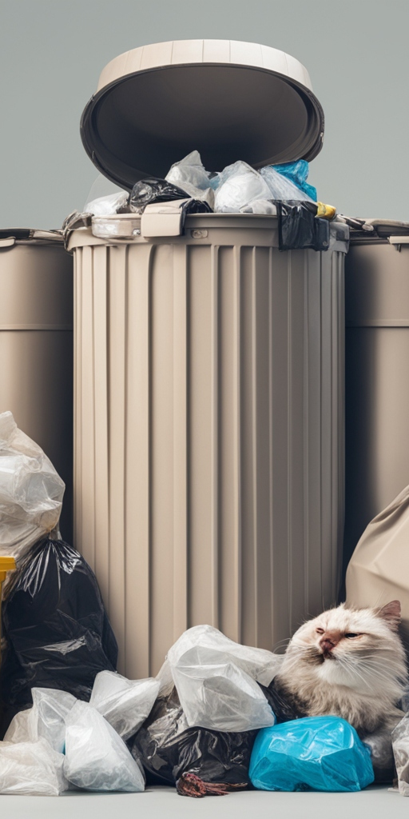
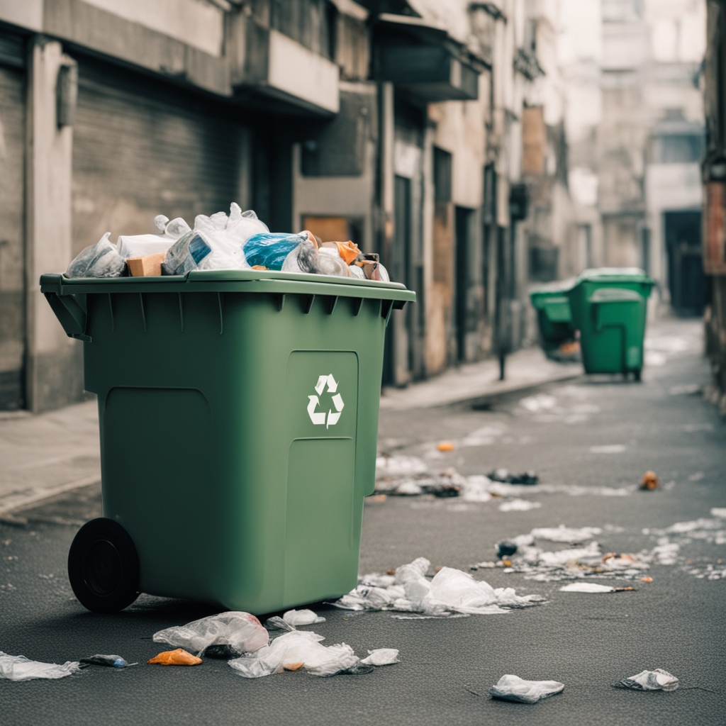
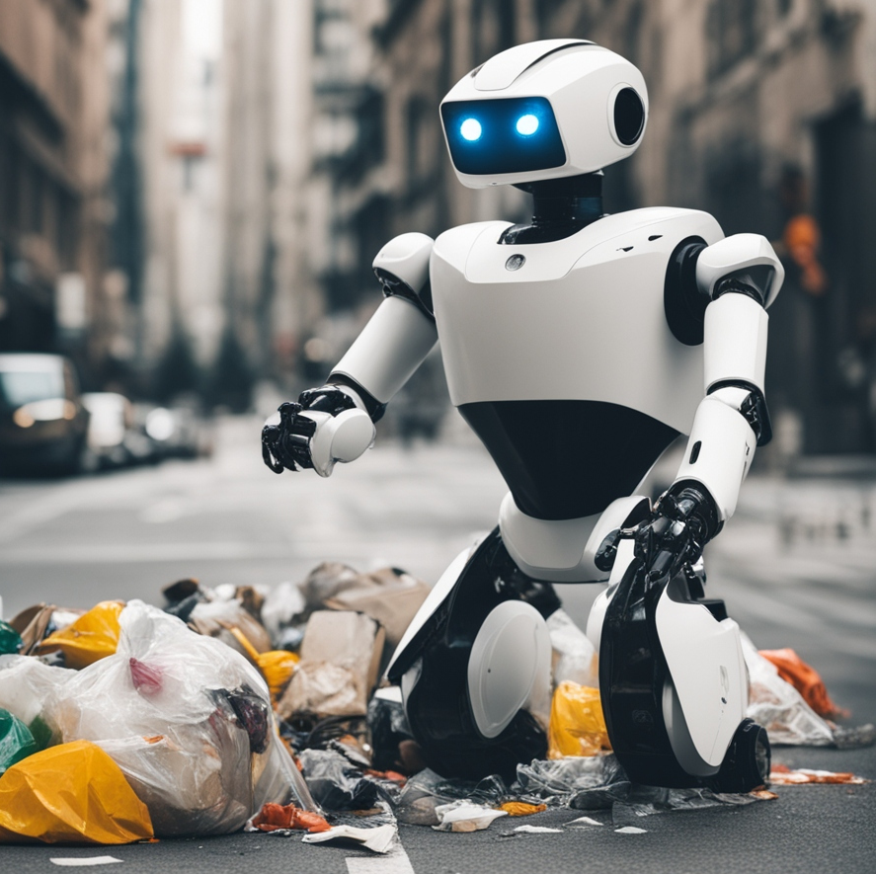
Primary objective
garbage detection system can effectively identify and classify garbage items, contributing to waste management efforts and environmental sustainability.
garbage detection system needs to operate in real-time, the algorithm should be efficient enough to process new data quickly and make predictions in a timely manner.
the machine learning model, especially for deep learning models that require significant computational resources.
This machine learning libraries and frameworks such as TensorFlow, PyTorch, or scikit-learn to implement and train the garbage detection model.

Slide 6

Secondary objective
Gather a diverse dataset of images containing both garbage and non-garbage items.
Preprocess the images to ensure they are in a consistent format and size.
This might involve resizing, normalization, and augmentation techniques to increase the diversity of your dataset.
computer vision techniques such as edge detection, texture analysis, and color histograms, or you can use deep learning models to automatically learn features from the data.

Slide 7
Advantages
Machine learning-based garbage detection systems can identify waste materials swiftly, allowing for prompt intervention and disposal.
Implementing such systems can potentially reduce the costs associated with manual waste sorting and disposal.
By accurately identifying and sorting waste, these systems contribute to reducing pollution and preserving natural resources.
Automation through machine learning enables continuous monitoring and sorting of waste, enhancing overall operational efficiency.
Advanced algorithms improve the accuracy of waste classification, minimizing errors and optimizing resource allocation.

Slide 8
Disadvantages
Garbage detection systems in machine learning may struggle with accuracy, especially in complex or cluttered environments, leading to false positives or negatives.
Poor data quality or lack of diverse datasets can hinder the system's effectiveness.
Variations in lighting, weather conditions, or object positioning can affect the performance of garbage detection models, making them less robust in real-world scenarios.
The initial setup and ongoing maintenance costs of garbage detection systems can be high, which may not be affordable for all organizations or municipalities.

Slide 9
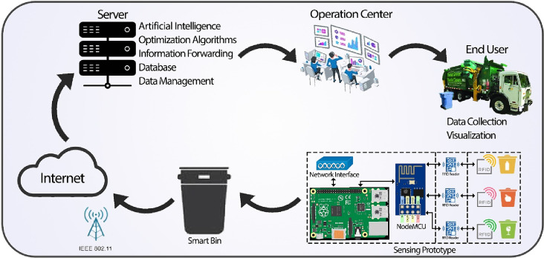

Slide 10
Test cases
Ensure the system correctly identifies containers with no garbage as empty.
Test with various container shapes and sizes to validate robustness.
Test with both known contaminants and unknown samples to gauge effectiveness.
Result
Provides real-time or near-real-time feedback on garbage presence, enabling swift action for cleanup or prevention measures.
Offers potential applications in waste management, environmental monitoring, and smart city initiatives.
Contributes to efforts in promoting environmental sustainability and reducing pollution

Slide 11
Functional Requirements
detect various types of garbage items such as plastic bottles, cans, wrappers, etc.
A user-friendly interface for configuring, monitoring, and managing the system.
Provision of alerts or notifications to appropriate authorities or personnel upon garbage detection.
privacy regulations and ethical considerations in handling image or video data.
cost-effective in terms of both hardware requirements and operational expenses.

Slide 12
Conclusion
Efficient garbage detection systems utilizing machine learning techniques show promising potential in addressing environmental challenges associated with waste management.
Through the utilization of image recognition algorithms, these systems can accurately classify and segregate various types of garbage, facilitating recycling efforts and reducing landfill waste.
The integration of machine learning algorithms enables real-time processing, enhancing the speed and accuracy of garbage detection, thus streamlining waste management processes.
Continuous refinement and optimization of machine learning models can further improve the accuracy and reliability of garbage detection systems, contributing to more sustainable and eco-friendly waste management practices.

Slide 13
Reference
Singh, A. Managing the uncertainty problems of municipal solid waste disposal. J. Environ. Manag. 2019, 240, 259–265. [Google Scholar] [CrossRef] [PubMed]
Jakovljevic, G.; Govedarica, M.; Alvarez-Taboada, F. A deep learning model for automatic plastic mapping using unmanned aerial vehicle (UAV) data. Remote Sens. 2020, 12, 1515. [Google Scholar] [CrossRef]
Hong, S.J.; Han, Y.; Kim, S.Y.; Lee, A.Y.; Kim, G. Application of Deep-Learning Methods to Bird Detection Using Unmanned Aerial Vehicle Imagery. Sensors 2019, 19, 1651. [Google Scholar] [CrossRef] [PubMed] [Green Version]
Ronneberger, O.; Fischer, P.; Brox, T. U-net: Convolutional networks for biomedical image segmentation. In Proceedings of the International Conference on Medical Image Computing and Computer-Assisted Intervention, Munich, Germany, 5–9 October 2015; Springer: Cham, Switzerland, 2015; pp. 234–241. [Google Scholar]

Slide 14
THANK YOU

